Slide 1



GREEN UNIVERSITY OF BANGLADESH
Department of CSE
Course : Web Programming Lab
Course Code: CSE-302 , Section: 231_D3
CSE-302 | 231-D3
Presentation on
Daily Mood Journal with Emoji Analysis
1

Slide 2

Presented BY
Presented TO
1
Promod Chandra Das
id: 231002005
Mr. Mozdaher Abdul Quader
Lecturer
Dept. of CSE
Green University of Bangladesh
2
Chinmoy Debnath id: 231902029
2

Slide 3
Agenda
1
2
3
4
Introduction
7
8
9
Testing and Result
O
Real life Analogy
Obstacles Encountered
o
Benefits of The tool
Limitations
Design
10
Future Scope
Learning Outcome
Conclusion
5
Feature
11
6
12
Workflow
3

Slide 4
Introduction
4
Project : Daily Mood Journal with Emoji Analysis.
Purpose :Track daily moods using emojis.
Desired Users : Students, Busy Professionals, Elder Peoples.
Platform: Web-based using HTML, CSS, JavaScript.
Goal: inspire people to keep track of their users reflect on overall well-being.

Slide 5
Real-Life Analogy
Think of it as a digital diary with access control :
Helps in mental health awareness
Easy to use and access anytime
Provides monthly mood trends for self-reflection
Simple and expressive emoji-based input

Slide 6
Benefits of the Tool
6
The problem it solves!
Inspired by humans mental health awareness.
Simple but interactive
Anyone with simple browsing knowledge can use it.
Help users reflect on emotional and mental health.

Slide 7
Design
7
Css is used for interactive and beautiful design
Clean and minimal UI using html and css
JavaScript powers interactive emoji selection and dynamic content updates.
Monthly calendar layout for reviews.
Responsive design for all devices.

Slide 8
Feature
8
Dark-themed Login Popup
Monthly Review with Chart.js
Mood Selection Interface
Mood and Note Saving
Emoji-based mood history
Doctor Support Suggestion

Slide 9
Workflow
9
Login : User enters username/password
Valid credentials show mood tracker.
Mood Selection : User selects one of 9 mood emojis.
Note Entry : Optional short note about the mood.
Save Mood: Stores date, mood, and note in local storage..
Monthly Review: Shows mood history and chart with mood counts (Chart.js).
Data Storage: All data saved in browser local storage.
Responsive Design: Works on both mobile and desktop.

Slide 10
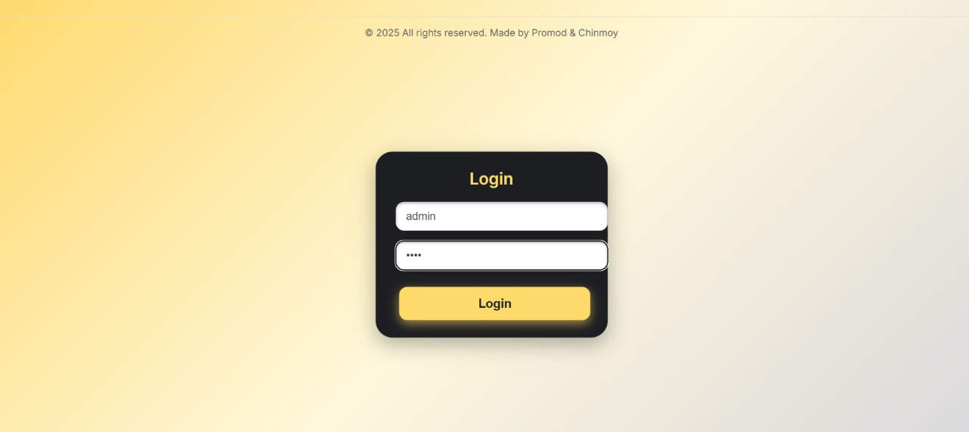
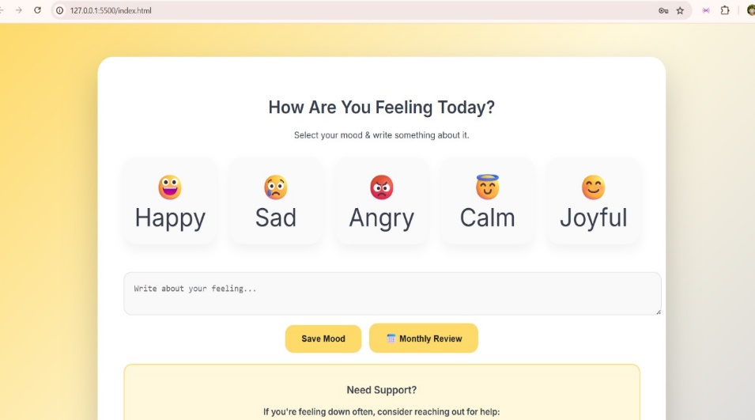
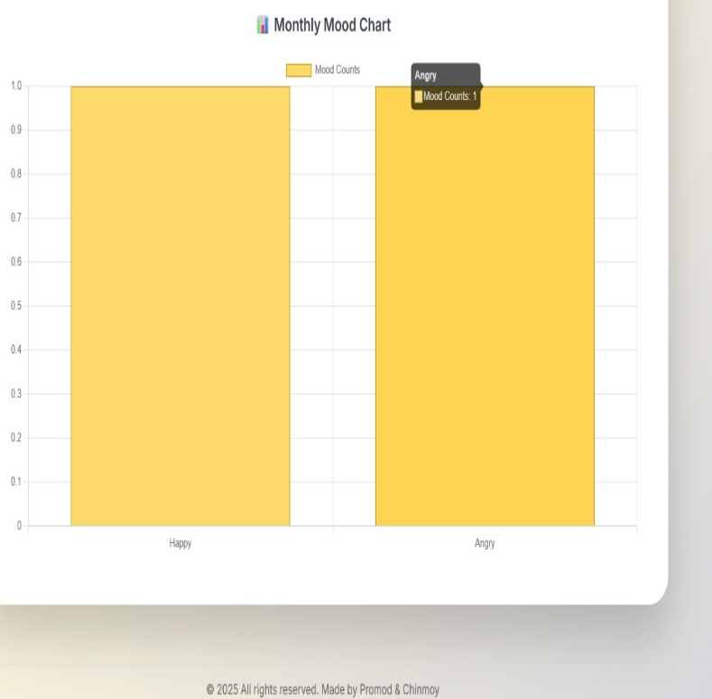
Testing & Result
10
Figure 01 :Login Screen
Figure 03 :Mood Selection
Figure 02 :Graph view

Slide 11
Obstacles Encountered
11
Testing Mood Logic.
Maintaining UI Consistency .
JavaScript Event Management.
Ensuring Mood Selection

Slide 12
Limitations
12
LocalStorage Only
No Encryption
Single User
Limited Analytics

Slide 13
Future Scope
13
Cloud Data Sync.
AI Mood Analysis.
Multi-user Session Handling.
Reminder & Notification System.

Slide 14
Learning Outcomes
14
Improved Web Development Skills
Problem-Solving & Testing.
Local Storage Utilization.
Basic Authentication Logic .
User Experience (UX) Focus.

Slide 15
Conclusion
Created an easy-to-use platform for daily emotional self-expression.
Enabled meaningful insights by visualizing mood patterns monthly.
Demonstrated effective use of web technologies without backend complexity.
Highlighted the potential of tech to support mental health awareness.

Slide 16
THANK YOU
16

